Slide 1
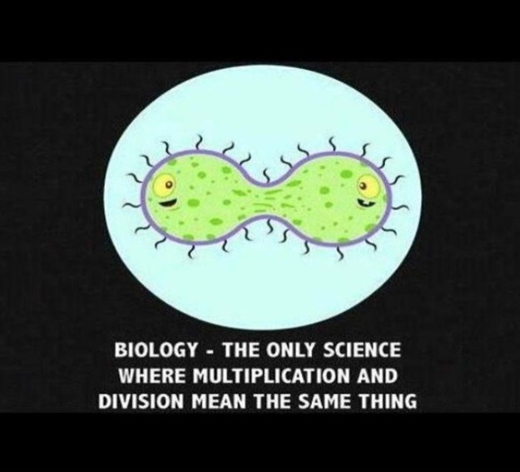
Cell GROWTH & REPRODUCTION

Slide 2
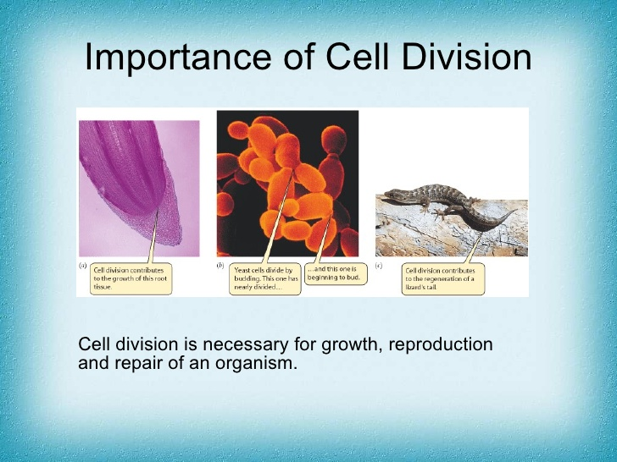
CELL DIVISION
The process by which a cell divides into two new daughter cells is cell division
IMPORTANCE OF CELL DIVISION
Cell division is necessary for growth, reproduction and repair of an organism

Slide 3
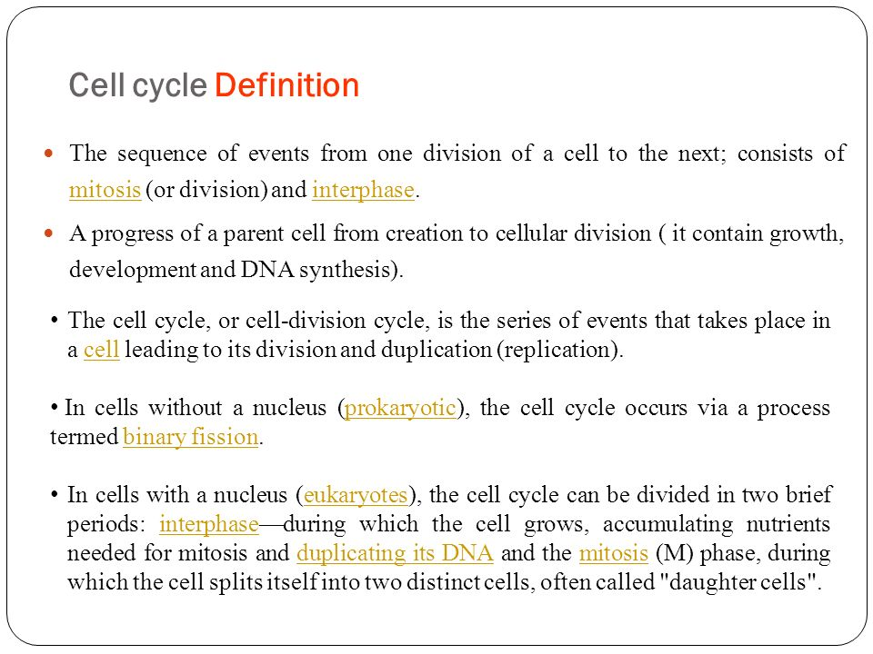
CELL CYCLE
The events are:
Production of Reproductive Signals
Duplication of genetic material and other vital components so that each cell after division becomes complete and identical to each other
Segregation of genetic material
Cytokinesis
Notes:
Production of Reproductive Signals: Environmental cues (Prokaryotic), needs of the whole organism (Eukaryotic)

Slide 5
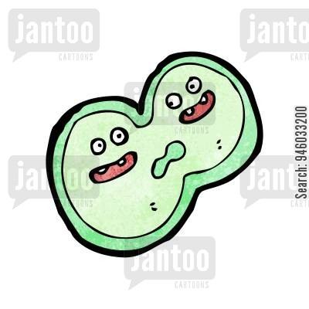
DIFFERENT TYPES OF CELL DIVISION
PROKARYOTIC CELL DIVISON - BINARY FISSION
EUKARYOTIC CELL DIVISON - MITOSIS
MEIOSIS

Slide 6
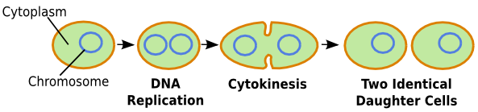
PROKARYOTIC CELL DIVISION
Cell wall
Septum formation
All prokaryotes reproduce asexually by binary fission. Binary fission is the splitting of a parent cell into two genetically identical daughter cells
Notes:
All prokaryotes reproduce asexually by binary fission. Binary fission is the splitting of a parent cell into two genetically identical daughter cells
1) Production of Reproductive Signals: Environmental cues
2) Replication of genetic material: Single, circular chromosome duplicates itself. Replication starts at “ori” (origin of replication) region and ends at “ter” (terminus of replication) region. Replisomes (several functional enzymes) helps the replication of circular DNA.
3) Segregation of DNA: By the end of replication, the two new chromosomes separate from each other and are partitioned to opposite ends of the lengthened cell.
4) Cytokinesis: Formation of division septum in the center of the cell occurs to divide the cell into 2 identical daughter cells.

Slide 7
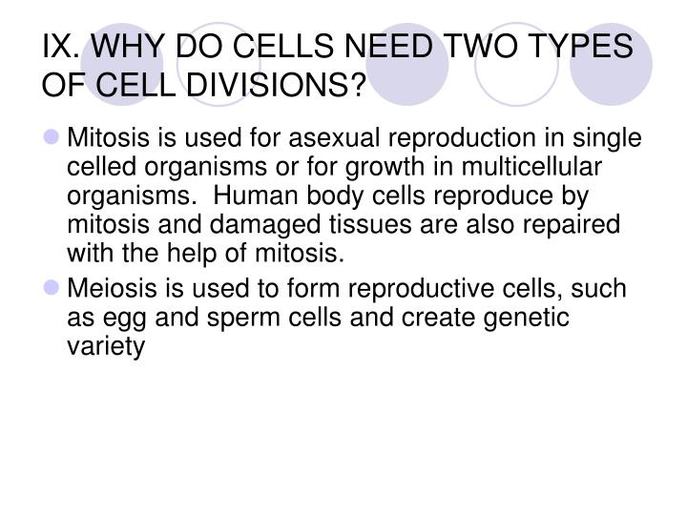
WHY DO EUKARYOTIC CELLS NEED TWO TYPES OF CELL DIVISION

Slide 8
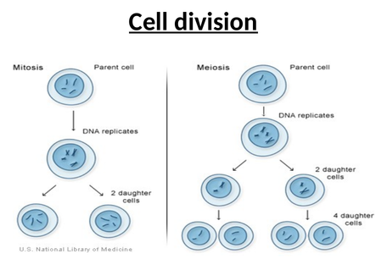
DNA replication
DNA replication
Cell division
Cell division
2 daughter cells
Cell division
2 daughter cells
4 daughter cells

Slide 9
EUKARYOTIC CELL DIVISION
Cell division in eukaryotes, like that in prokaryotes, involves DNA replication, segregation and cytokinesis, but are much more complicated.
A eukaryotic cell cycle is divided into
Interphase: G1, S and G2 phase
M phase: Prophase, Metaphase, Anaphase, Telophase, Cytokinesis

Slide 10
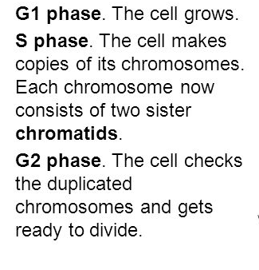
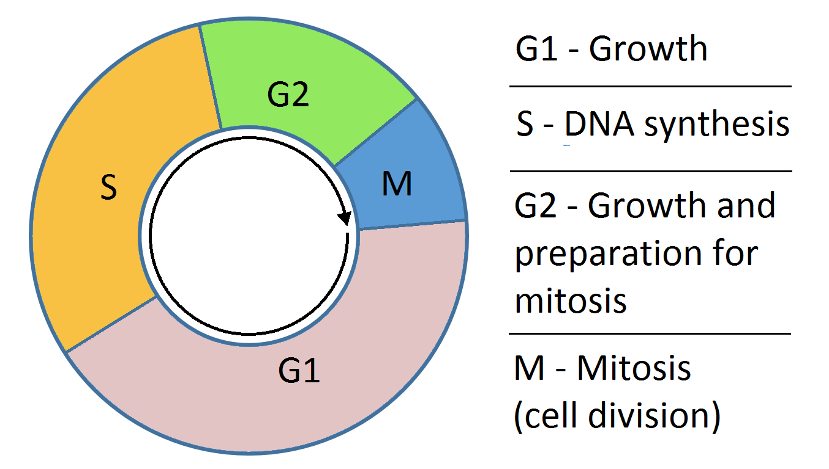
INTERPHASE
like for example synthesizes microtubules that will help in segregation of chromosomes.

Slide 11
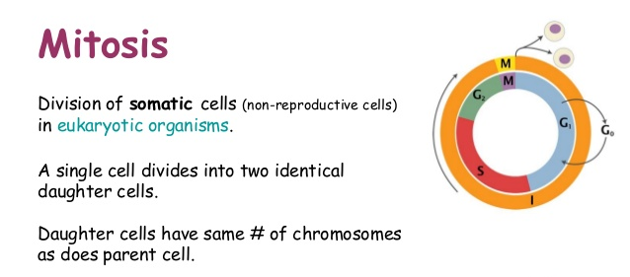
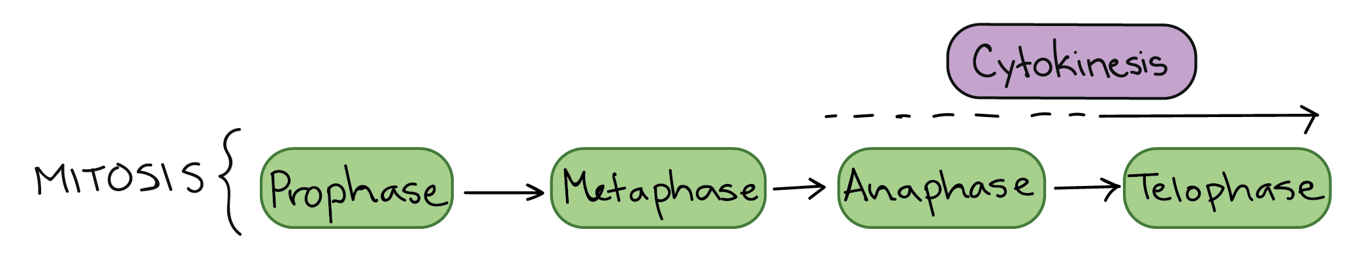
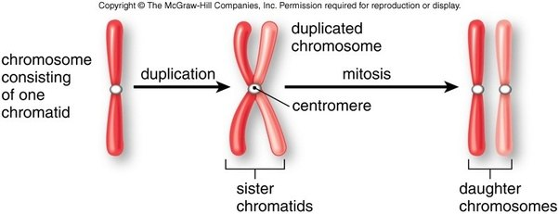
I PMAT C

Slide 12
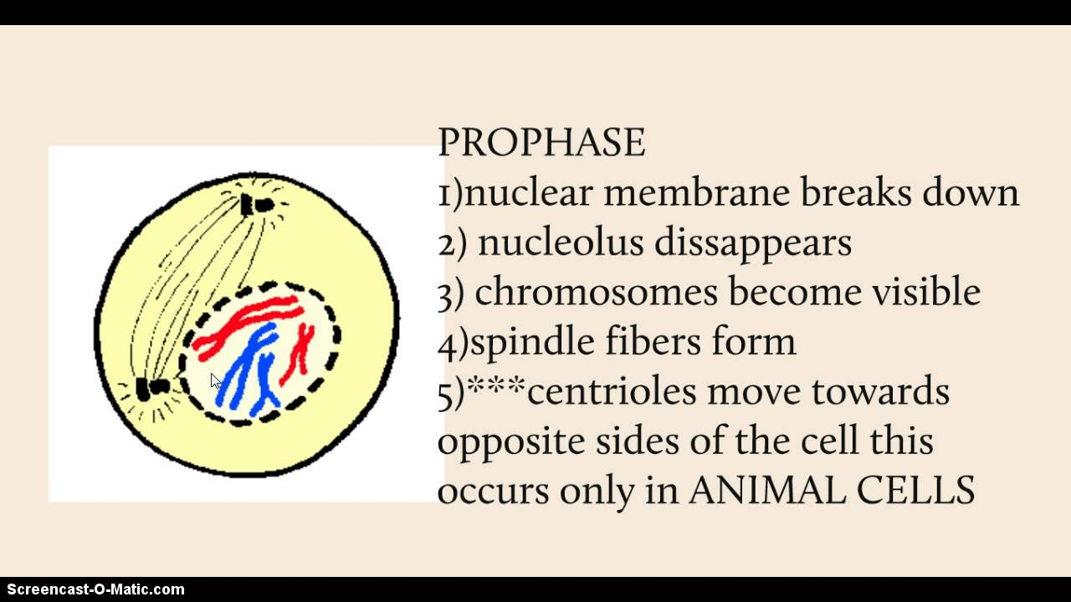
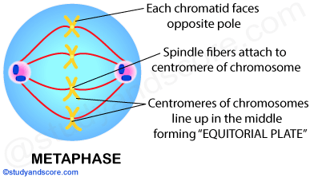
MITOSIS
Notes:
Chromosomes most condensed in METAPHASE
Longest phase of cell cycle is INTERPHASE
Longest phase of cell division is PROPHASE
Shortest phase of cell division is ANAPHASE

Slide 13
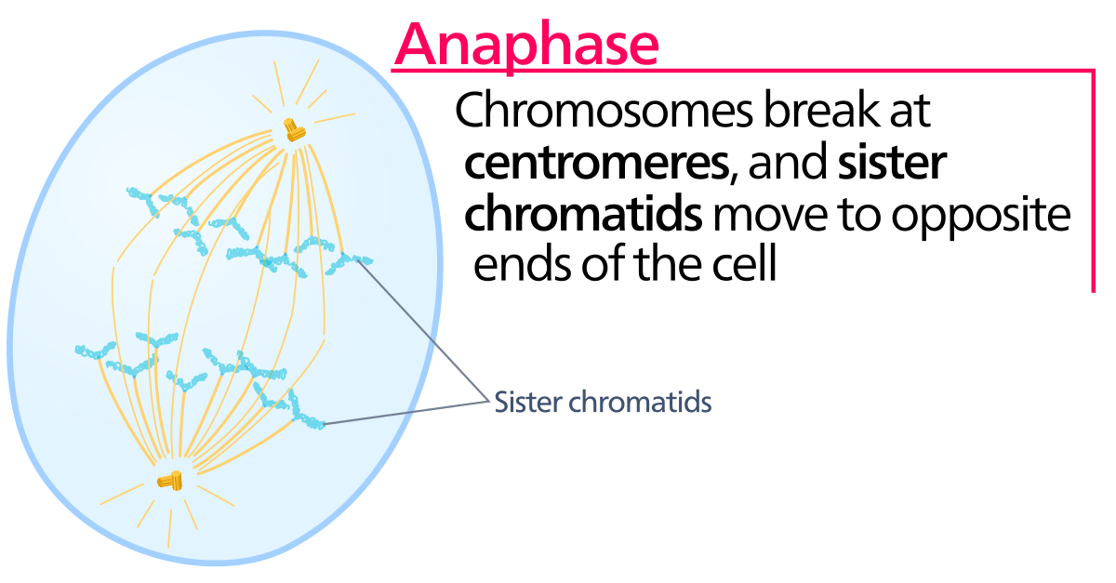
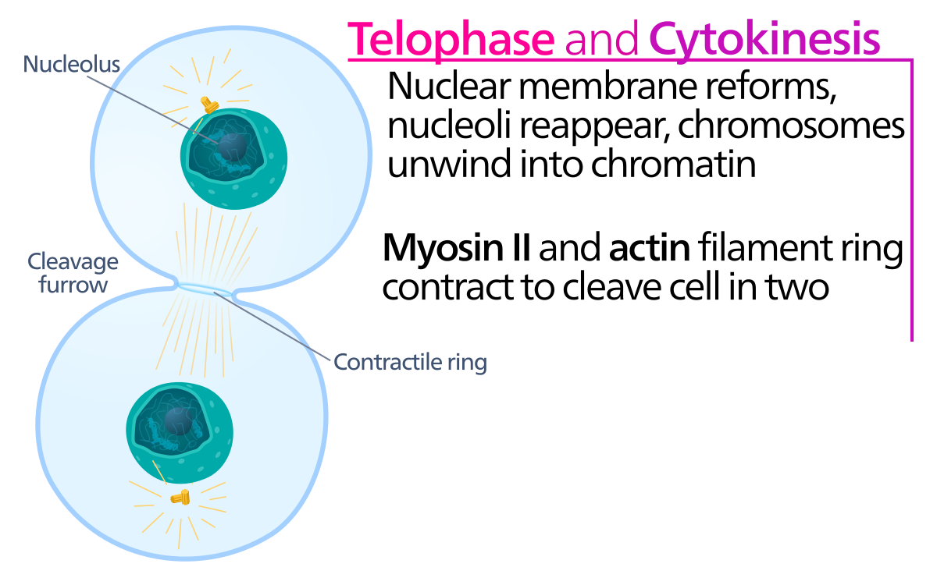

Slide 14
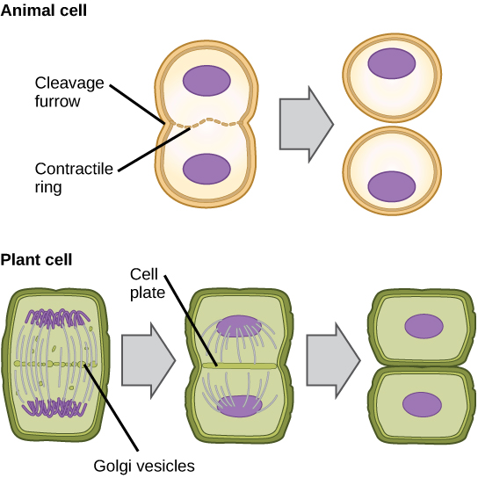
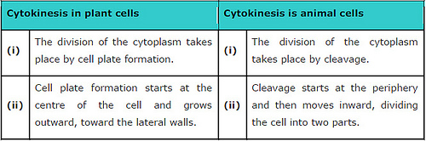
CTYTOKINESIS IN PLANTS AND ANIMALS

Slide 15
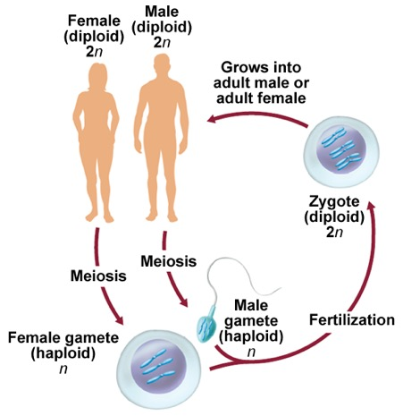
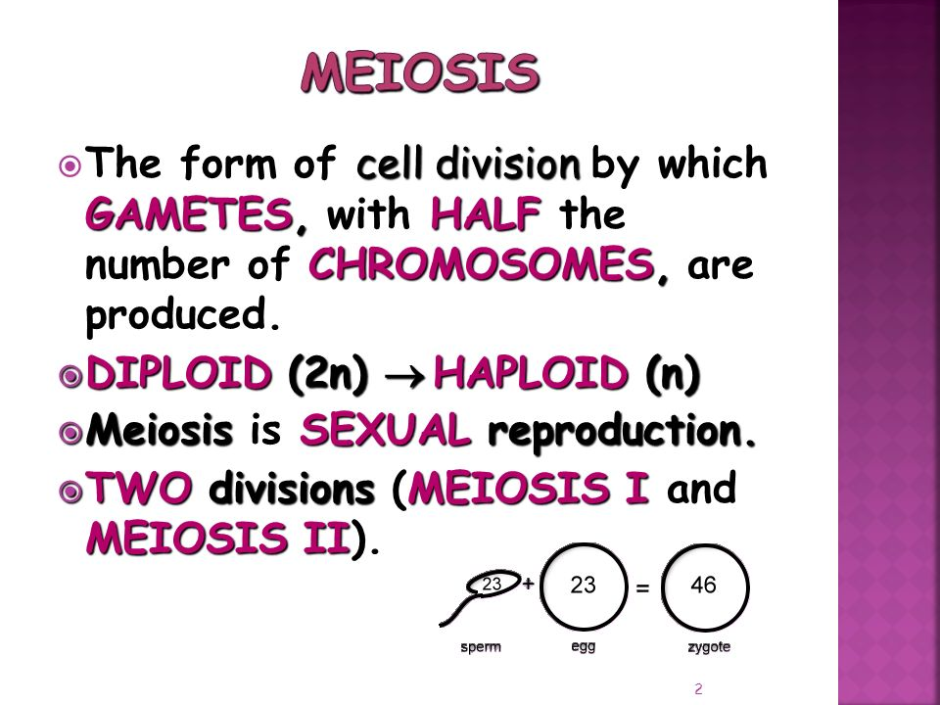
MEIOSIS
Although, the nucleus divides twice during meiosis, DNA is replicated only once.

Slide 16
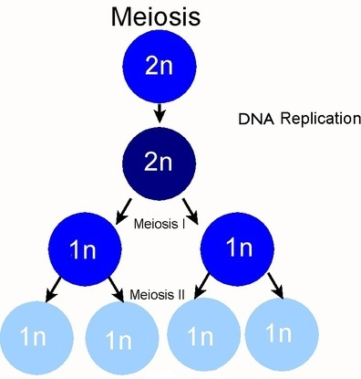
Meiosis occurs in two stages: Meiosis I and Meiosis II
Meiosis I
Chromosome number is halved (Reduction Division)
Chromosome number is maintained (Equational division)
Meiosis II

Slide 17
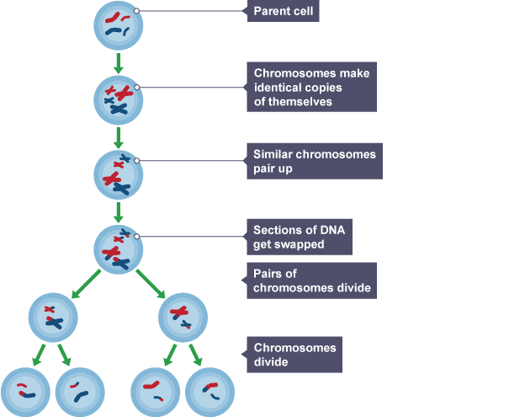
Notes:
Homologous chromosomes are made up of chromosome pairs of approximately the same length, centromere position, and staining pattern, for genes with the same corresponding loci. The alleles on the homologous chromosomes may be different, resulting in different phenotypes of the same genes.

Slide 18
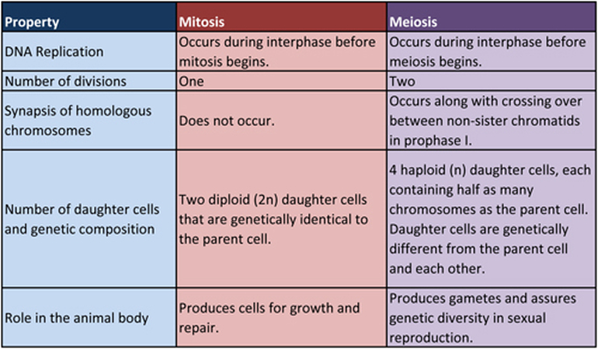

Slide 19
Questions
Explain the process of binary fission in prokaryotes?
Explain the process of cell cycle in living organism?
Elaborate the interphase stage of cell cycle?
Explain mitosis? What are the different stages of mitosis and explain their characteristic features?
How is the process of cytokinesis different in plants and animals?
Explain meiosis briefly.
What are the major difference between the process of mitosis and meiosis?
What is the significance of mitosis and meiosis?

